Slide 1
Vortex Fury HD
Jacob Powell

Slide 2
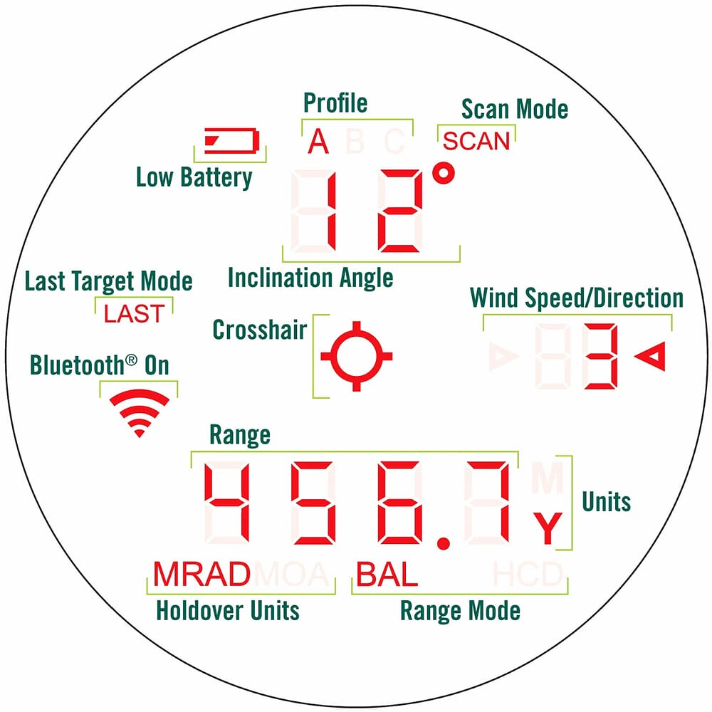
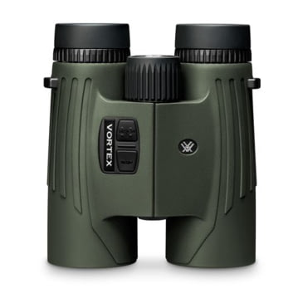
Application Description
Vortex Fury HD is a cross platform mobile application that allows users to sync the Vortex Optics Fury HD 5000 AB via a Bluetooth connection.

Slide 3
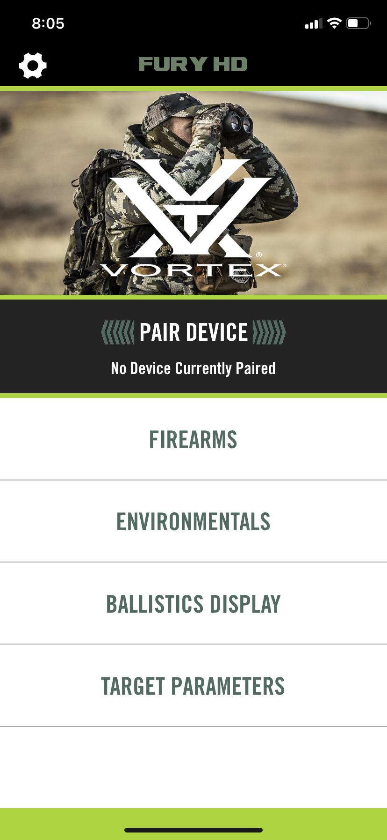
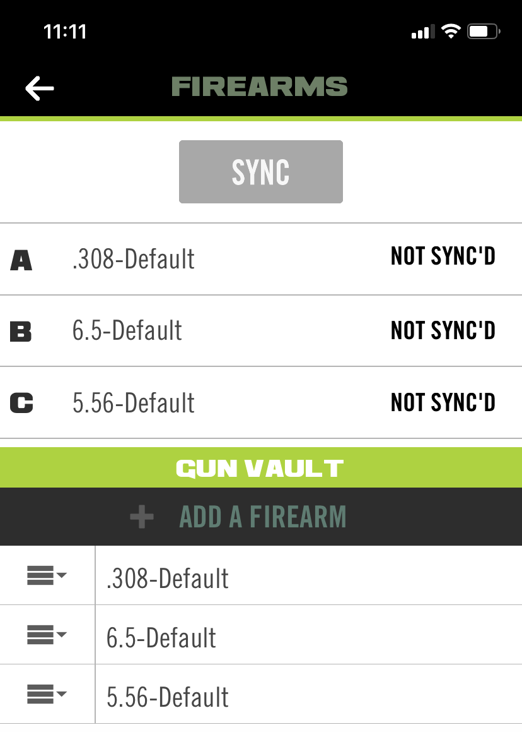
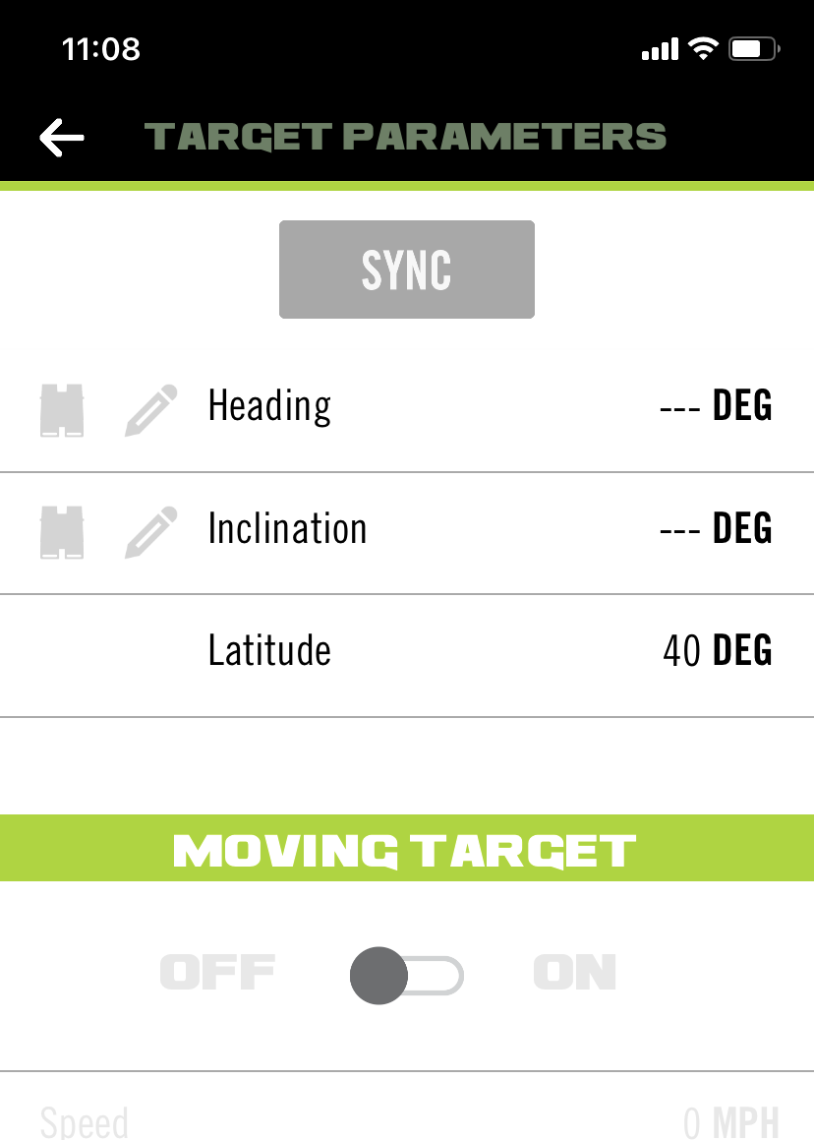
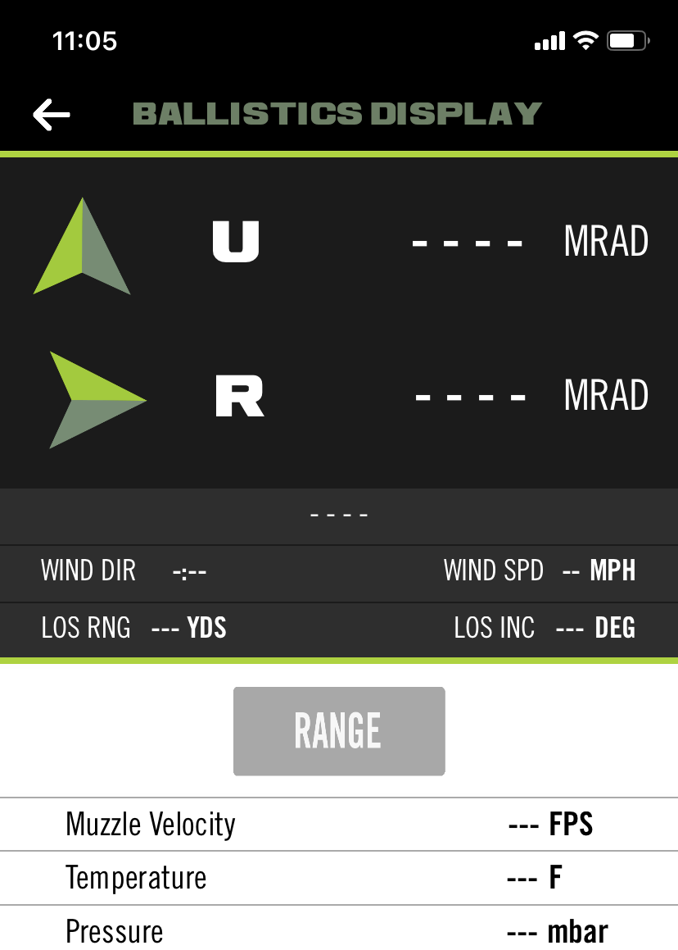
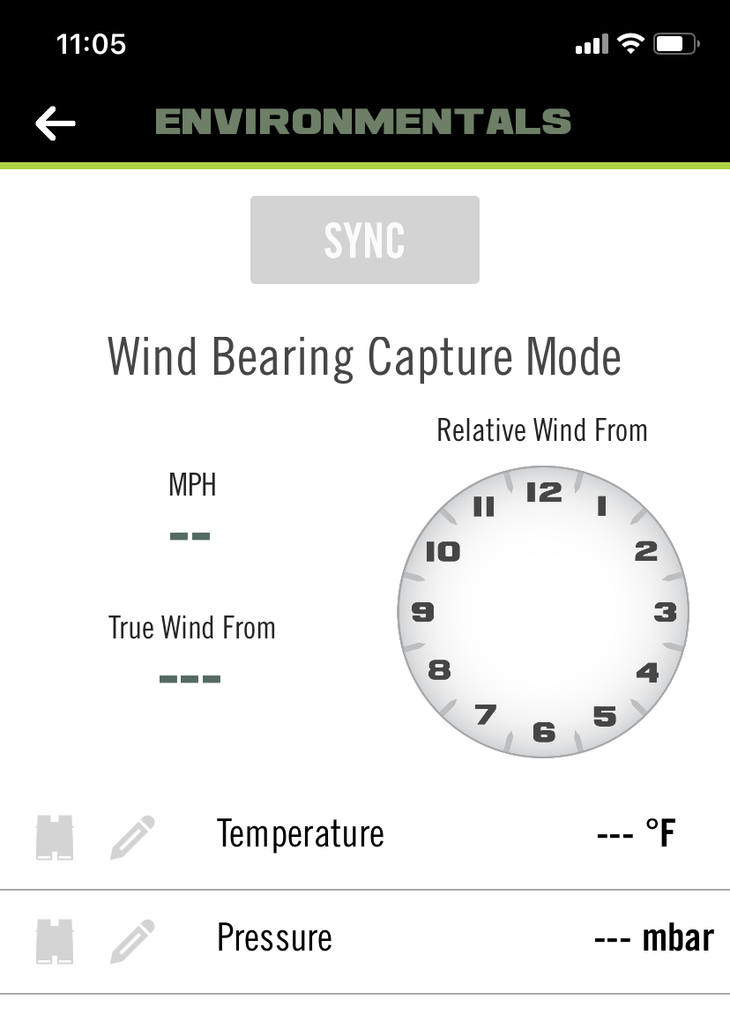
Application Overview

Slide 4
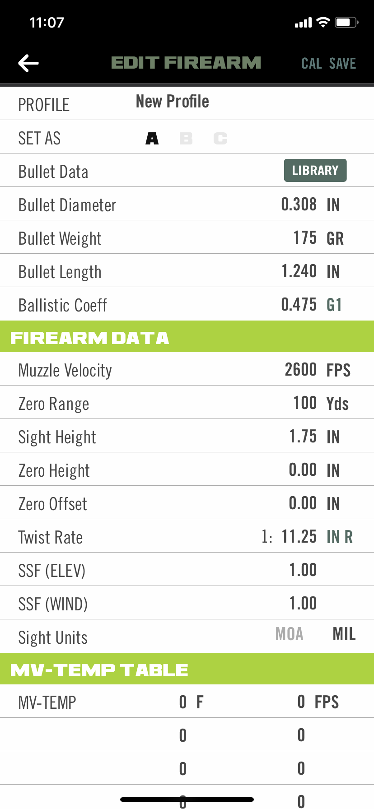
Pros
Save preferences while app is closed.
High amount of customizability for users.
Preset user preferences
User profiles

Slide 5
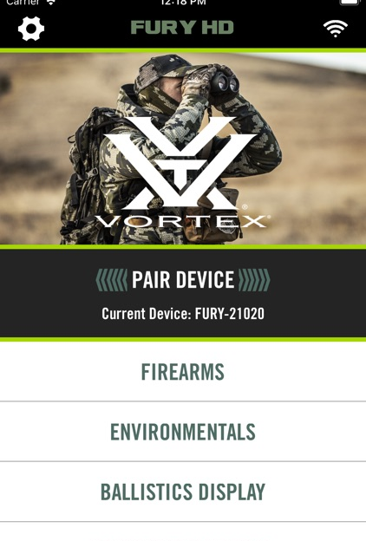
Cons
Click listeners are confined to the text of the buttons in the app.
App not letting the user know if the calibration has been saved
Connection is severed is app closes or screen shuts off.
Doesn’t ignore dark mode in application pop ups.

Slide 6
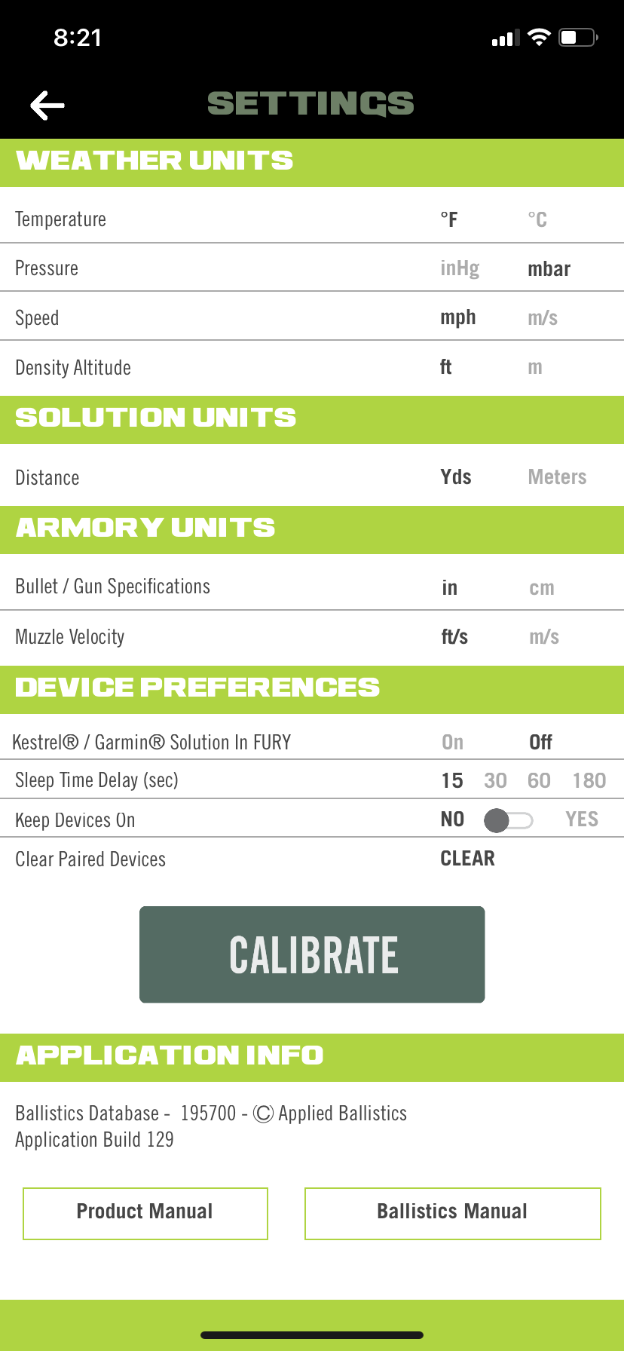
Button changes
Create larger ranges for the click listeners.

Slide 7
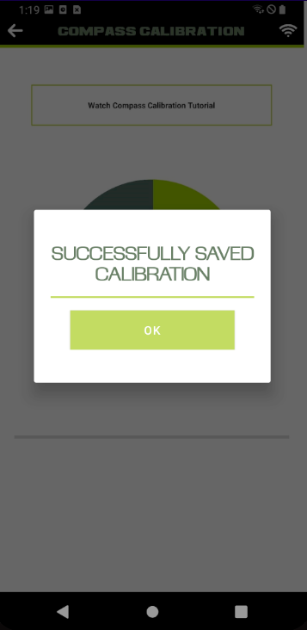
Calibration Settings
Have binoculars ping the Fury application when the calibration is successfully saved.
Saves potential time during recalibration

Slide 8
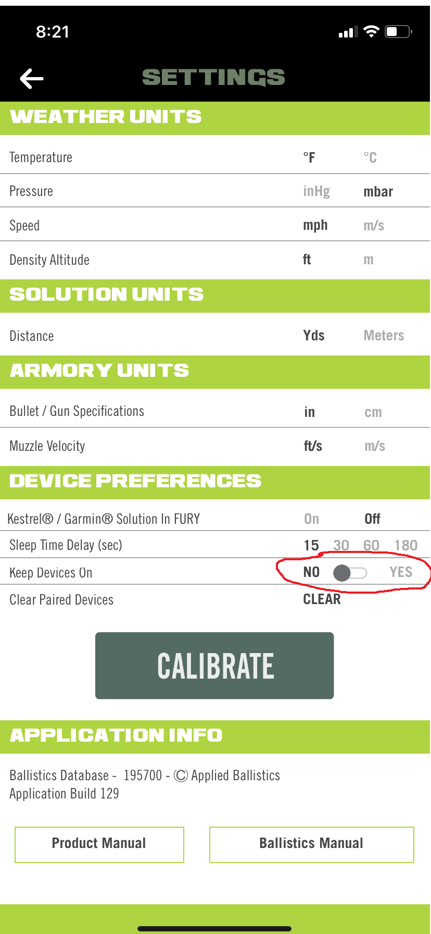
Connection Changes
Set keep devices on to yes as a default on first time set up of the application.

Slide 9
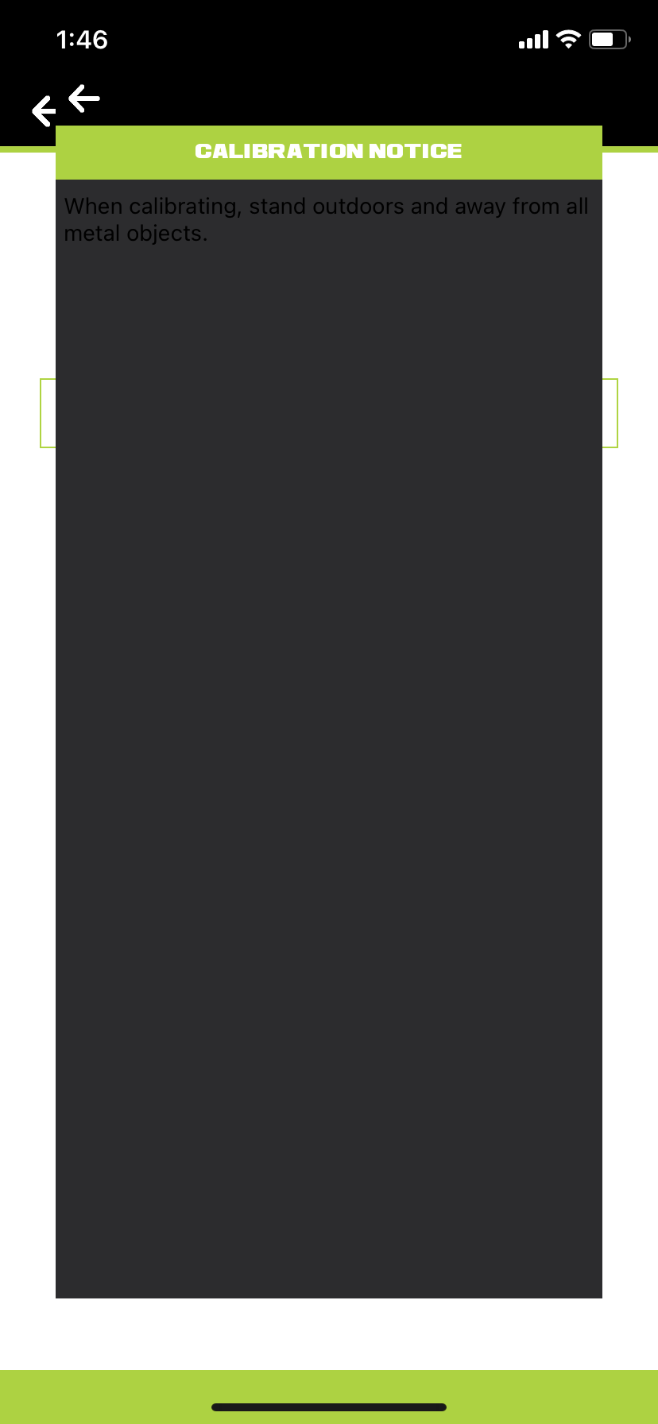
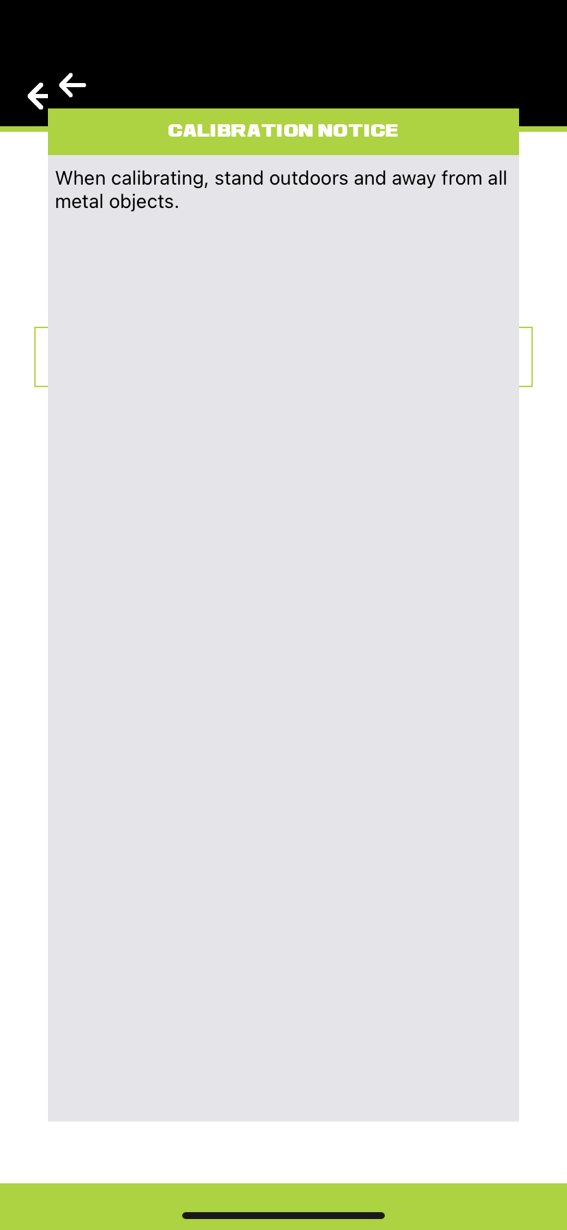

Dark Mode Changes
Set application to ignore dark mode.
How to:
Android/Kotlin:
iOS/Swift:

